Slide 1

GLMMs in R, STATA, SPSS
Narges Sohrabi
August 2015

Slide 2
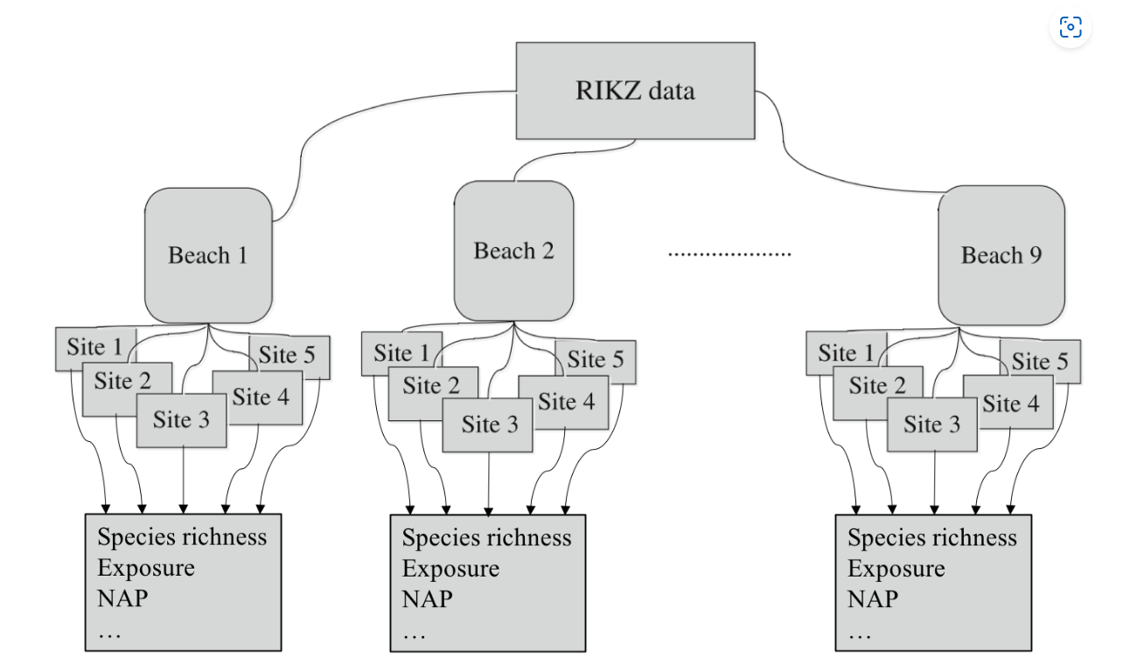
The RIKZ dataset
For each of 9 intertidal areas (denoted ‘Beaches’), the researchers sampled five sites (denoted ‘Sites’) and at each site they measured abiotic variables and the diversity of macro-fauna (e.g. aquatic invertebrates). Here, species richness refers to the total number of species found at a given site while NAP ( i.e. Normal Amsterdams Peil) refers to the height of the sampling location relative to the mean sea level and represents a measure of the amount of food available for birds, etc. For our purpose, the main question is:
What is the influence of NAP on species richness?

Slide 3
Example in R (Standard linear regression)
library(tidyverse)
# Load data
rikz_data <- "https://uoftcoders.github.io/rcourse/data/rikz_data.txt"
download.file(rikz_data, "rikz_data.txt")
rikz_data <- read_delim("rikz_data.txt",
col_names = TRUE,
delim = "\t")
rikz_data <- rikz_data %>%
mutate(Beach = as.factor(Beach))
# Examine structure of the dataframe and view first 5 columns
str(rikz_data)
# Run basic linear model using all of the data.
basic.lm <- lm(Richness~ NAP, data = rikz_data)
summary(basic.lm)

Slide 4
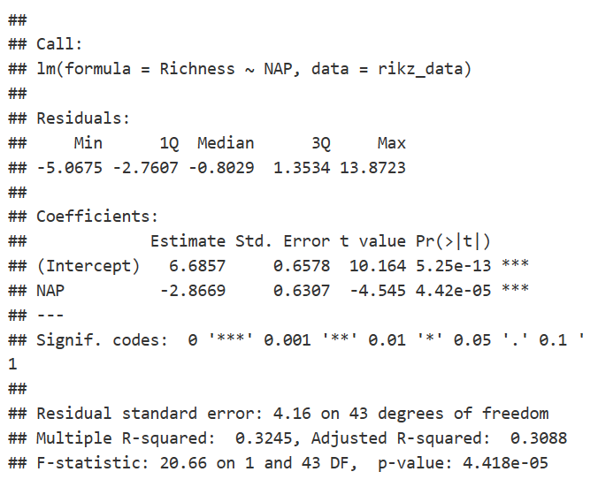
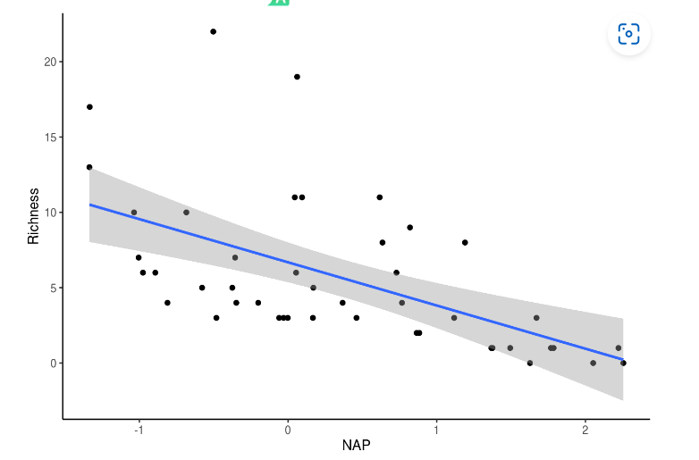
RESULT
From the model output above, it looks like NAP is significantly, negatively (Estimate < 0) associated with species richness. Let’s plot this relationship to see what it looks like.
# Plot relationship from above model ggplot(rikz_data, aes(x = NAP, y = Richness)) +geom_point() +geom_smooth(method = "lm") + theme_classic()
However, before we trust this result, we should confirm that the assumptions of the linear regression are met. We can plot the residuals against the fitted values (homogeneity and independence) and a QQ-plot (normality). Thankfully, R’s base plotting function does all of this work for us.

Slide 5
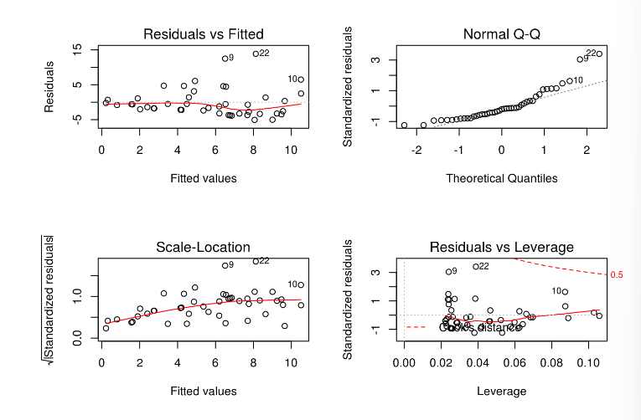
# Check assumptions.
# Normality homogeneity of variance violated
par(mfrow=c(2,2))
plot(basic.lm)
The first and third panels suggest that the homogeneity assumption is violated (increasing variance in the residuals with increasing fitted values). Similarly, panel 2 suggests non-normality (points falling off of the dotted line). A third-root transformation of the response variable (i.e. Richness) seems to alleviate both of these problems.
Tip: Right skewed response variables can be normalized using root transformations (e.g. square root, log, third-root, etc.), with greater roots required for increasingly right-skewed data. Left skewed response variables can be normalized with power transformations (e.g. squared, 3rd power, etc.)
Nonetheless, for the analyses in this section, we will ignore violations of these assumptions for the purpose of better illustrating mixed-effects modelling strategies on untransformed data. In fact, these data violate another, potentially more problematic assumption; namely, the observations are not independent.

Slide 6
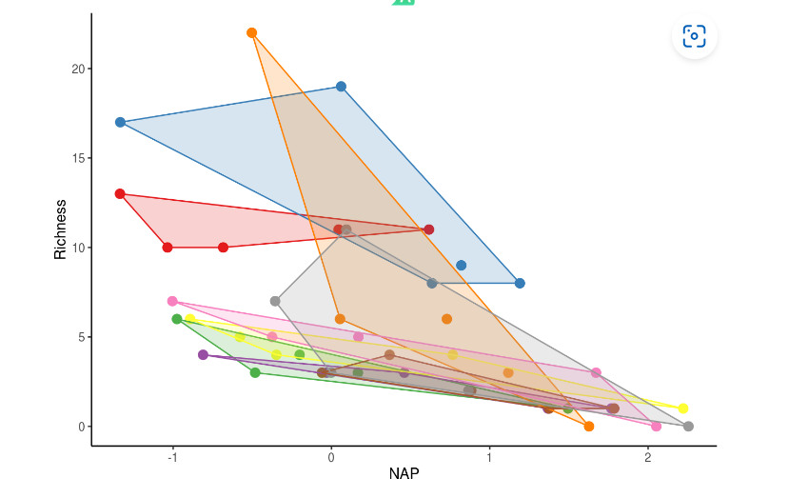
Non-independence of observations
each beach may be independent, sites within a beach are likely to have similar species richness due simply to their proximity within the same beach.
In other words, observations among sites within a beach are not independent
Another way of saying this is that the data are nested.
Other types of nested data include: sampling the same individual pre- and post-treatment or sampling them multiple times (i.e. repeated measures), or sampling multiple tissues from the same individuals.
library(plyr)
# Function to find polygons
find_hull <- function(df) df[chull(df$Richness, df$NAP), ]
# Identify polygons in data
hulls <- ddply(rikz_data, "Beach", find_hull)
# Plot
ggplot(rikz_data, aes(x = NAP, y = Richness, colour = Beach)) +
geom_point(size = 3) +
theme_classic() +
theme(legend.position = "none") +
scale_colour_brewer(palette="Set1") +
scale_fill_brewer(palette="Set1") +
geom_polygon(data=hulls, aes(fill = Beach), alpha = 0.2)
observations from the same beach tend to cluster together.
We need to account for this non-independence in our modelling
Notes:
Remember, the species richness data come from multiple sites within multiple beaches. While each beach may be independent, sites within a beach are likely to have similar species richness due simply to their proximity within the same beach. In other words, observations among sites within a beach are not independent. Another way of saying this is that the data are nested. Nesting in this sense is a product of the experimental design (i.e. we chose to sample 5 sites within each beach) and not necessarily of the data itself. Other types of nested data include: sampling the same individual pre- and post-treatment or sampling them multiple times (i.e. repeated measures), or sampling multiple tissues from the same individuals. We can visualize the non-independence of observation within the same beach by producing a figure similar to the one above but clustered by beach (each beach is a different colour).

Slide 7
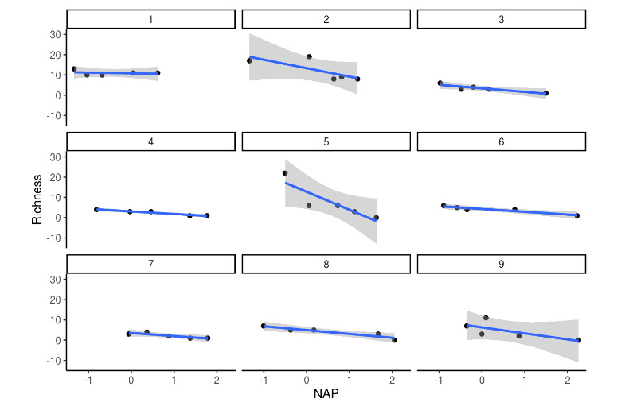
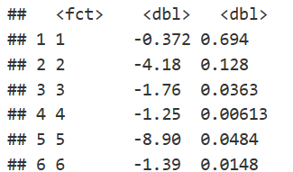
Accounting for non-independence
One approach to account for this non-independence would be to run a separate analysis for each beach, as shown in the figure and table below.
# We could account for non-independence by running a separate analysis
# for each beach
ggplot(rikz_data, aes(x = NAP, y = Richness)) +
geom_point() +
geom_smooth(method = "lm") +
facet_wrap(~ Beach) +
xlab("NAP") + ylab("Richness") +
theme_classic()
# Run linear model of Richness against NAP for each beach
beach_models <- rikz_data %>%
group_by(Beach) %>%
do(mod = lm(Richness ~ NAP, data = .))
# Get the coefficients by group in a tidy data_frame
library(broom)
dfBeachModels = tidy(beach_models, mod)
dfBeachModels %>%
filter(term == "NAP") %>%
dplyr::select(estimate, p.value)
the issue with this approach is that each analysis only has 5 points (a really low sample size!) and we have to run multiple tests. As such, we run the risk of obtaining spuriously significant results purely by chance.

Slide 8
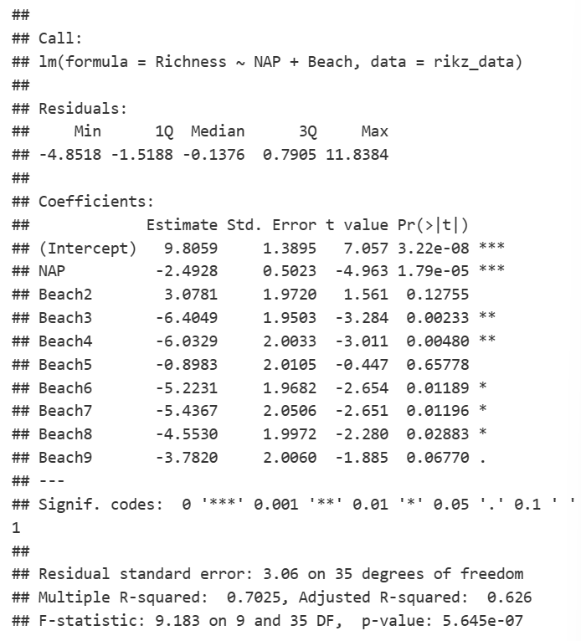
we can simply include a term for beach in our model, thereby estimating its effects
basic.lm <- lm(Richness ~ NAP + Beach, data = rikz_data)
summary(basic.lm)
The model is estimating a separate effect for each level of beach (8 total since 1 is used as the reference)
Notes:
That’s a lot of terms! Note what’s happening here. The model is estimating a separate effect for each level of beach (8 total since 1 is used as the reference). Because we need one degree of freedom to estimate each of these, that’s a total of 8 degrees of freedom! In this case, it had little effect of changing our interpretation of the effects of NAP on richness (which is still negative and significant). However, sometimes the inclusion of additional terms in this way will change the estimated effect of other terms in the model and alter their interpretation. The question we need to ask ourselves here is: Do we really care about differences between beaches? Maybe but probably not. These beaches were a random subset of all beaches that could have been chosen but we still need to account for the non-independence of observations within beaches. This is where random-effects become useful.
Random-effect models

Slide 9
Example
A fast food chain plans to add a new item to its menu. However, they are still undecided between three possible campaigns for promoting the new product. In order to determine which promotion has the greatest effect on sales, the new item is introduced at locations in several randomly selected markets. A different promotion is used at each location, and the first month sales of the new item recorded.

Slide 10
GLM
Multiple responses from the same subject cannot be regarded as independent from each other.
testmarket_1month.sav in spss
Politeness data in R

Slide 11
Examples in medicine or
Count data
Binary data
number of side effects after treatment
number of living piglets in a litter
number of episodes in multiple sclerosis patients
Presence (yes/no) of respiratory infection in children
Pain relief (yes/no) after analgesic treatment
Correct solution (yes/no) to a task or test question

Slide 12
Example in Marketing
A shipping company can use generalized linear models to fit a Poisson regression to damage counts for several types of ships constructed in different time periods, and the resulting model can help determine which ship types are most prone to damage.

Slide 13
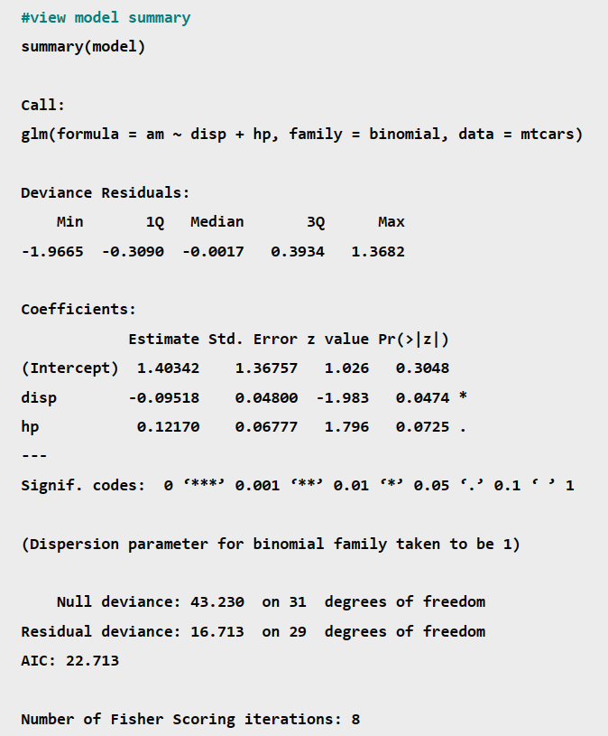
Example with R
we’ll use the built-in mtcars dataset in R:

Slide 14
Coefficients & P-Values
The coefficient estimate in the output indicate the average change in the log odds of the response variable associated with a one unit increase in each predictor variable.For example, a one unit increase in the predictor variable disp is associated with an average change of -0.09518 in the log odds of the response variable am taking on a value of 1. This means that higher values of disp are associated with a lower likelihood of the am variable taking on a value of 1.
The standard error gives us an idea of the variability associated with the coefficient estimate. We then divide the coefficient estimate by the standard error to obtain a z value.For example, the z value for the predictor variable disp is calculated as -.09518 / .048 = -1.983.
The p-value Pr(>|z|) tells us the probability associated with a particular z value. This essentially tells us how well each predictor variable is able to predict the value of the response variable in the model.For example, the p-value associated with the z value for the disp variable is .0474. Since this value is less than .05, we would say that disp is a statistically significant predictor variable in the model.
Depending on your preferences, you may decide to use a significance level of .01, .05, or 0.10 to determine whether or not each predictor variable is statistically significant.

Slide 15
Null & Residual Deviance
The null deviance in the output tells us how well the response variable can be predicted by a model with only an intercept term.
The residual deviance tells us how well the response variable can be predicted by the specific model that we fit with p predictor variables. The lower the value, the better the model is able to predict the value of the response variable.To determine if a model is “useful” we can compute the Chi-Square statistic as:
X² = Null deviance – Residual deviance
with p degrees of freedom.We can then find the p-value associated with this Chi-Square statistic. The lower the p-value, the better the model is able to fit the dataset compared to a model with just an intercept term.
For example, in our regression model we can observe the following values in the output for the null and residual deviance:
Null deviance: 43.23 with df = 31
Residual deviance: 16.713 with df = 29
We can use these values to calculate the X² statistic of the model:
X² = Null deviance – Residual deviance
X² = 43.23 – 16.713
X² = 26.517
There are p = 2 predictor variables degrees of freedom.
We can use the Chi-Square to P-Value Calculator to find that a X² value of 26.517 with 2 degrees of freedom has a p-value of 0.000002.
Since this p-value is much less than .05, we would conclude that the model is highly useful.

Slide 16
Example with STATA
CODES
Model of y as a function of x when y is a proportion
glm y x, family(binomial)
Logit model of y events occurring in 15 trials as a function of x
glm y x, family(binomial 15) link(logit)
Probit model of y events as a function of x using grouped data with group sizes n
glm y x, family(binomial n) link(probit)
Model of discrete y with user-defined family myfamily and link mylink
glm y x, family(myfamily) link(mylink)
Bootstrap standard errors in a model of y as a function of x with a gamma family and log link
glm y x, family(gamma) link(log) vce(bootstrap)
Menu
Statistics > Generalized linear models > Generalized linear models (GLM)
glm fits generalized linear models. It can fit models by using either IRLS (maximum likelihood) or Newton–Raphson (maximum likelihood) optimization, which is the default
Notes:
rglm.pdf (stata.com)

Slide 17
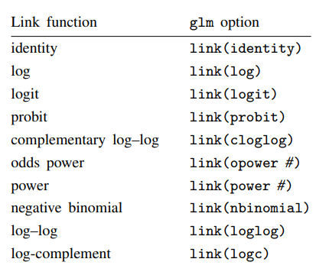
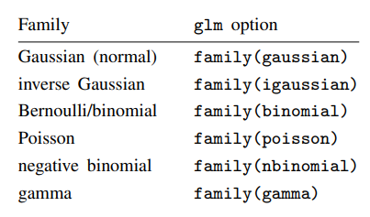
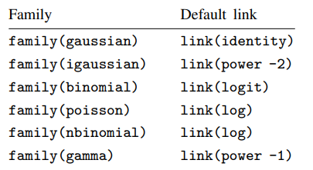
In any case, you specify the link function by using the link() option and specify the distributional family by using family().

Slide 18
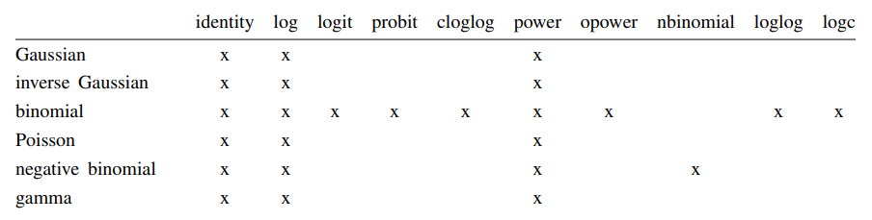
If you specify both family() and link(), not all combinations make sense. You may choose from the following combinations:

Slide 19
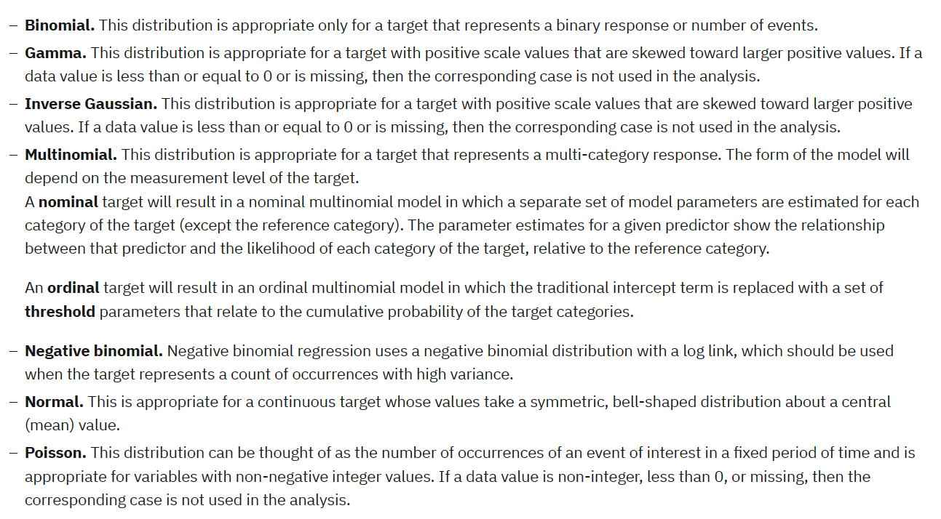
distributions

Slide 20
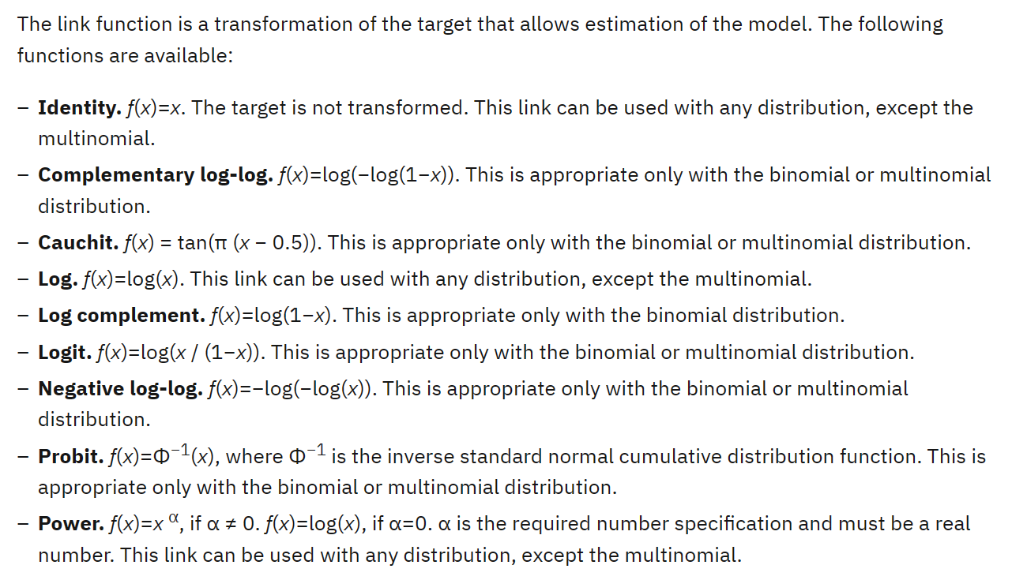
Link function

Slide 21
EXAMPLE
Medical researchers can use a generalized linear mixed model to determine whether a new anticonvulsant drug can reduce a patient's rate of epileptic seizures. Repeated measurements from the same patient are typically positively correlated so a mixed model with some random effects should be appropriate. The target field, the number of seizures, takes positive integer values, so a generalized linear mixed model with a Poisson distribution and log link may be appropriate.
Executives at a cable provider of television, phone, and internet services can use a generalized linear mixed model to know more about potential customers. Since possible answers have nominal measurement levels, the company analyst uses a generalized logit mixed model with a random intercept to capture correlation between answers to the service usage questions across service types (tv, phone, internet) within a given survey responder's answers.

Slide 22
Example in SPSS
The district school board wants to know if an experimental teaching method is effective at improving math scores. They select at random schools within the district, then some classrooms within each school. The classrooms are randomly assigned to the experimental or control group, and the classroom teachers are asked to use the new or standard method to teach mathematics in the coming school year. All students within the classrooms are tested at the beginning and end of the school year. The data have a hierarchical 3-level structure: school – class – student with 23 schools, 97 classes and 2209 students.
This information is collected in test_scores.sav
The target, Yijk, is the test score after a teaching method is applied for a year at school i, class j and student k. The possible predictors come from different levels.

Slide 23
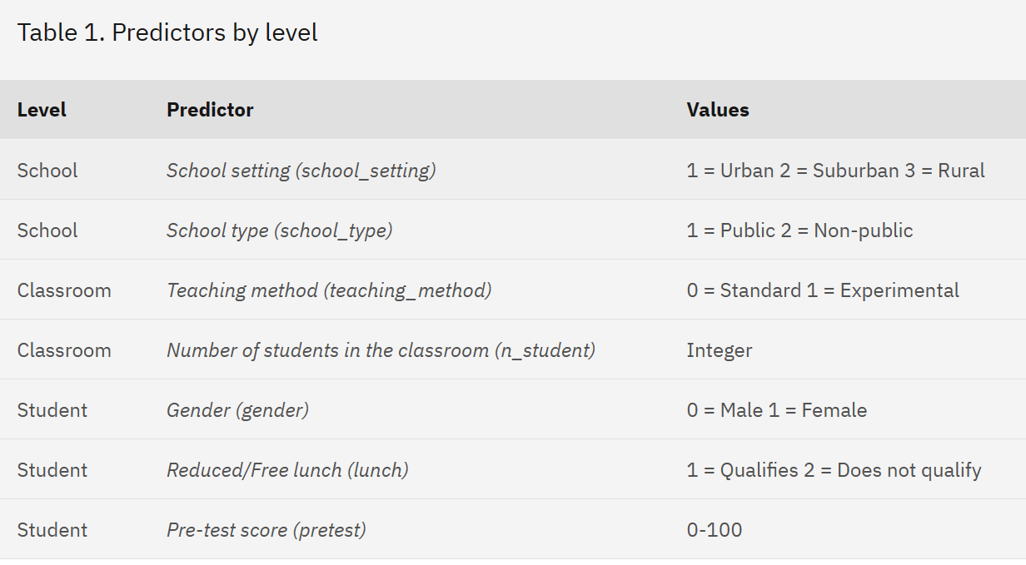

Slide 24
Select School (school), Classroom (classroom), and Student ID (student_id) as subject fields
On the Target settings, confirm that Post-test (posttest) is selected as the target. Post-test (posttest) has a predefined role as a target, so it is automatically selected as the target by default.
Confirm that Linear model is selected in the Target Distribution and Relationship (Link) with the Linear Model group. The linear model assumes a normal distribution for the target and uses an identity link function.
in Fixed Effects Confirm that Use custom inputs is selected.
Select School setting, School type, Teaching method, Number of students in the classroom, Gender, Reduced/Free lunch, and Pre-test, and drag to the Main drop zone to create the main effects.The fields with categorical (flag, nominal, or ordinal) measurement level are treated as factors by the procedure and those with continuous (scale) measurement level are treated as covariates.
In Random Effects, Confirm that two intercept-only random effect subject blocks exist; one with school as the subject field and one with school*classroom as the subject field. The procedure automatically creates a Random Effect block for each subject beyond the innermost subject.The first block should account for correlation between classrooms within the same school. The second block should account for correlation between students within the same classroom.
Click run

Slide 25
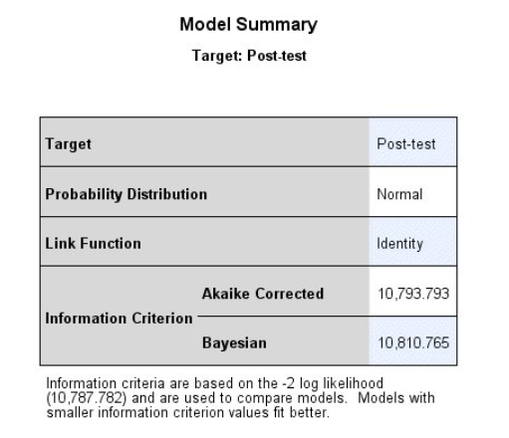
Result:Model Summary
By default, the procedure creates a model object in the output Viewer. Alternatively, you can generate pivot tables and charts by selecting Pivot tables and charts in the Output Display group on the Output tab of the Options dialog (Edit > Options).
This example uses the model object. Activate the object by double-clicking on it.
The first visible model view is a high-level summary of the model and its fit. Confirm basic model selections like the choices of target, probability distribution, and link function. Three fit values are listed:
Akaike Corrected. The Akaike information criterion, corrected (AICC) is a measure for selecting and comparing models based on the -2 log likelihood. Smaller values indicate better models. The AICC "corrects" the Akaike information criterion (AIC) for small sample sizes. As the sample size increases, the AICC converges to the AIC. The AIC "penalizes" overparametrized models.
Bayesian. The Bayesian information criterion (BIC) is a measure for selecting and comparing models based on the -2 log likelihood. Smaller values indicate better models. The BIC also penalizes overparametrized models, but more strictly than the AIC because the BIC accounts for the size of the dataset as well as the size of the model.
-2 log likelihood. Listed in a footnote under the table, the -2 log likelihood is the basis for the AIC and BIC.

Slide 26
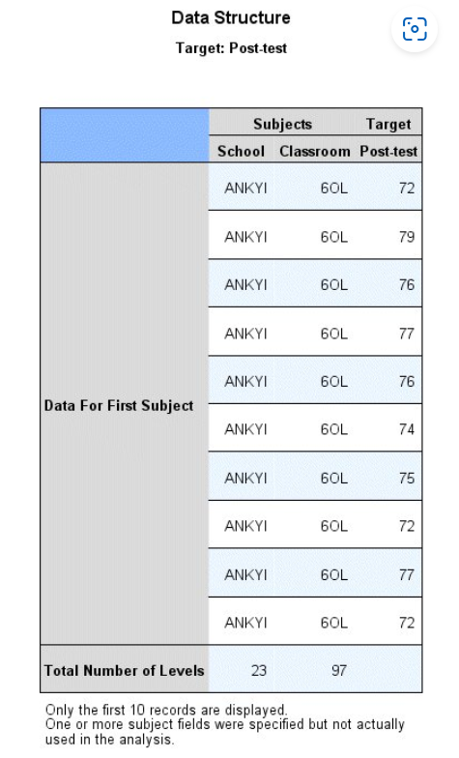
Result: Data Structure
This view helps you to confirm your data structure selections, and shows the actual values for the first subject. Note that though you specified Student ID on the data structure tab, it is not displayed in the table because it is not used in the model, either as a subject specification in a random effect block or for repeated measures (there are no repeated measures in the model at all). The purpose of specifying Student ID as a subject in the dialog is largely for the automatic creation of the random effect blocks that use school and school*classroom for subject effects, and because it is natural to think of each student as an individual subject in the study.

Slide 27
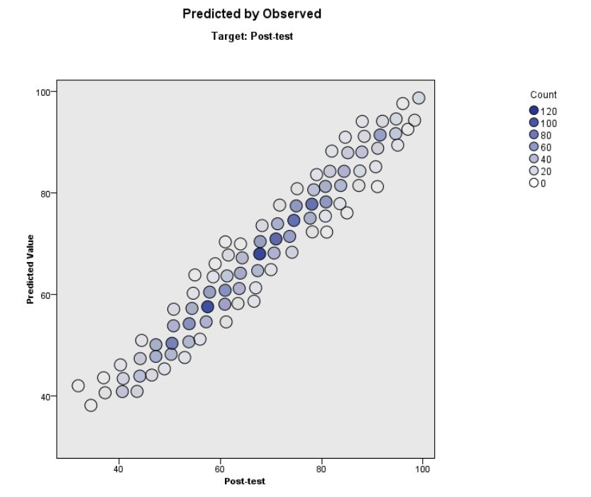
Predicted by Observed
The points lie near the diagonal, which means that no records are fit badly by the model.

Slide 28
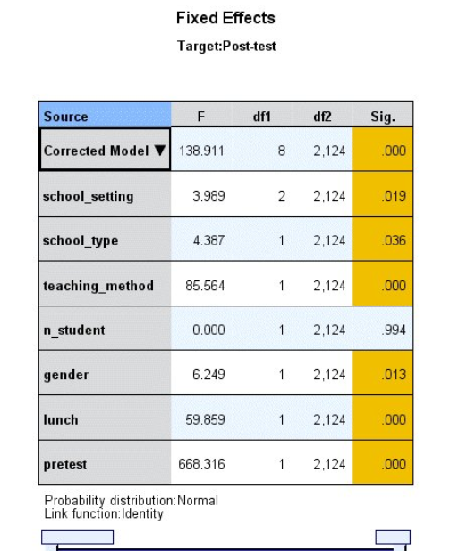
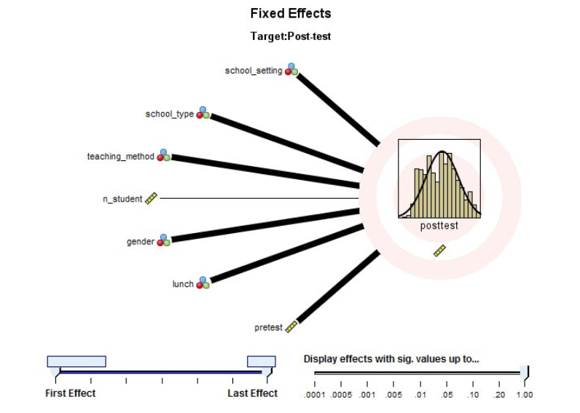
Fixed Effects
This is a visualization of the traditional tests of fixed effects table. The effects are ordered from top to bottom in the order in which they were specified on the Fixed Effects settings, and the thickness of each connecting line is based on the statistical significance of the effect. Note that this view displays field names rather than field labels because, under the assumption that field labels will generally be longer than field names, displaying labels for interactions and nested effects would quickly become unwieldy.
This is the traditional tests of fixed effects table for the overall model and individual effects. The model, and all effects except n_student (Number of students in the classroom), appear to be statistically significant.

Slide 29
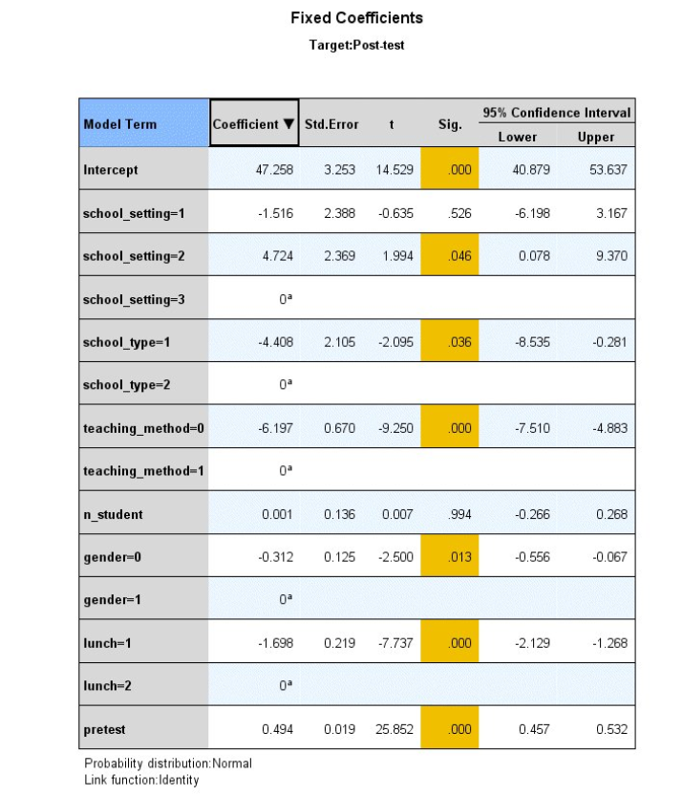
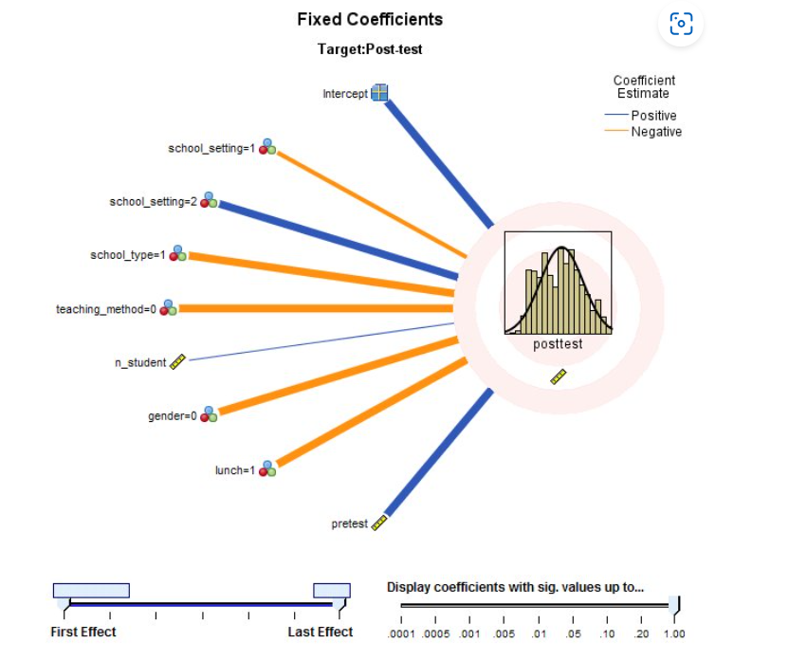
Fixed Coefficients
This is the traditional parameter estimates table for the overall model and individual effects. The coefficients show the relationship of each model parameter to Post-test score. For a continuous field, the coefficient is the expected change in test score for a unit increase in the value of the continuous field. For example, the value of 0.001 for n_student (Number of students in the classroom) means that, all other things being equal, we would expect the test score of a student in a classroom with 16 students to be 0.001 points higher than the score of a student in a classroom with 15 students.
For the categorical fields in this model, the coefficient is the expected change in test score relative to the reference category of the categorical field. The reference category is the last (highest valued) category, marked as redundant (meaning that the parameter is equal to a linear combination of other parameters in the model), and its coefficient value is set to 0. For example, the reference category for school_setting (School setting) is school_setting=3 , and the value of 4.724 for school_setting=2 means that, all other things being equal, we would expect the test score of a student at a suburban school to be 4.724 points higher than a student at a rural school.

Slide 30
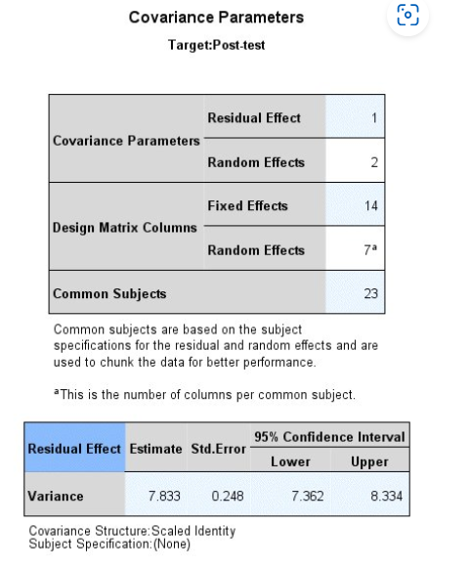
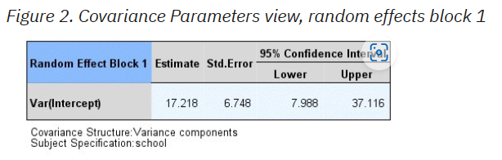
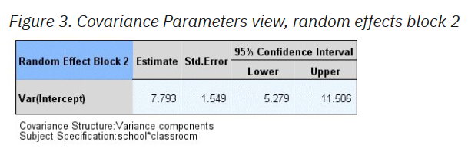
Covariance Parameters
This view displays the covariance parameter estimates and related statistics for residual and random effects. The residual (R) covariance parameters are shown by default. There are no repeated measures, so there is a single variance estimate for the residuals.
This is the variance estimate for the intercept of the random effect with school defining subjects, and is a measure of the between-school variation. The estimate is large relative to the residual variance and (looking ahead) the variance for Block 2, suggesting that most of the variability in test scores that is not explained by the fixed effects can be explained by school-to-school variation, but the standard error is also large, so there is a lot of uncertainty concerning the actual size of this effect.
This is the variance estimate for the intercept of the random effect with school*classroom defining subjects, and is a measure of between-classroom variation. The size of the effect is roughly equivalent to the residual variance, but with a little more uncertainty in the estimate; that is, a larger standard error.

Slide 31

Comparing to a linear regression model
The school board wonders whether the mixed model is better than a relatively simple linear regression model.
To fit a linear regression model, recall the Generalized Linear Mixed Models dialog.
On the Random Effects settings, select the two random effects blocks and delete them.
Click Run.

Slide 32
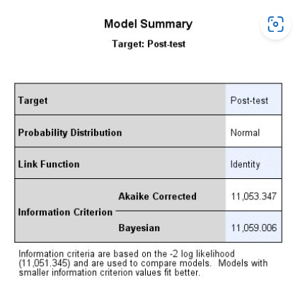
Model Summary
Based on the information criteria, the linear mixed model with two random intercepts is preferred over the linear regression model because it has smaller AICC (10793.793 < 11053.347) and BIC (10811.765 < 11059.006) values.
Based on a likelihood ratio test, the linear mixed model with two random intercepts is still preferred. Under the null hypothesis that the variances for the two random intercepts is zero, the difference in the −2 restricted log likelihoods (−2LL) for the two models has a chi-square distribution with degrees of freedom equal to the difference in the number of model parameters. The linear mixed model has a −2LL of 10787.782 and 12 parameters; the linear regression has a −2LL of 11051.344 and 10 parameters. The p value for the likelihood ratio test is the probability that a chi-square random variate with 12−10 = 2 degrees of freedom is larger than (11051.345 − 10787.782 = 263.563), which is near 0.

Slide 33
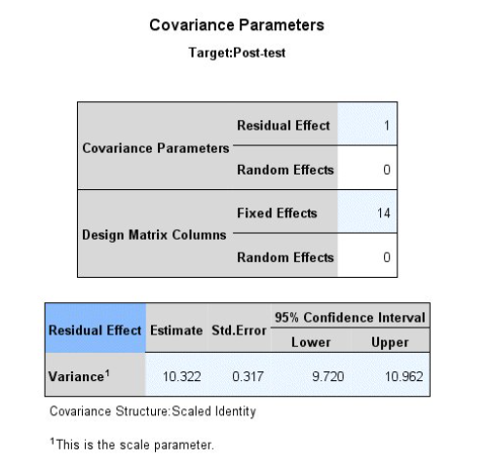
Covariance Parameters
The variance estimate for the residual effect is larger in the linear regression than in the linear mixed model. Given the information criteria and −2LL statistics, we expected the amount of variation left unexplained by the linear regression to be greater than the variation unexplained by the linear mixed model.

